Slide 1
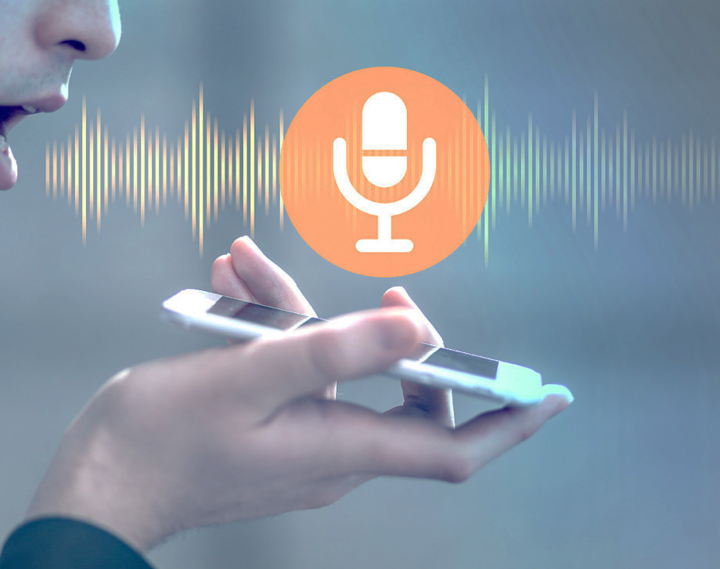
Accent Classifier: Predict accent of a speaker with deep neural network
Yiyan (James) Wan
Aalok Patel
Reshma Patil

Slide 2
Agenda
Background
Business Use Case
Data Description
Feature Extraction
Model
Conclusion
Demo

Slide 3


Why Accent Classifier?
Accents are still a source of error - even for the most robust ASR¹ systems
Accent classifier + ASR can theoretically outperform standalone ASR
Open up speech recognition to larger and more diverse user groups
An accent classification model can substantially improve current ASR applications
1 - Automatic speech recognition
Overview
Business use case
Data Description
Feature Extraction
Model Summary
Conclusion
Demo

Slide 4

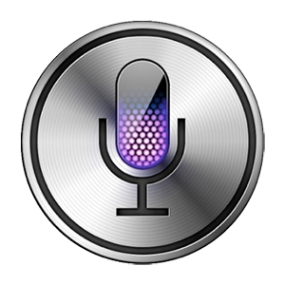

Applications
Forensic Sciences
Speech Recognition
Speech-to-text (e.g. automatic captioning and dictation tools)
Automated answering services
Speech Generation and Alteration
Interactive voice responses
Entertainment and media
Overview
Business use case
Data Description
Feature Extraction
Model Summary
Conclusion
Demo

Slide 5
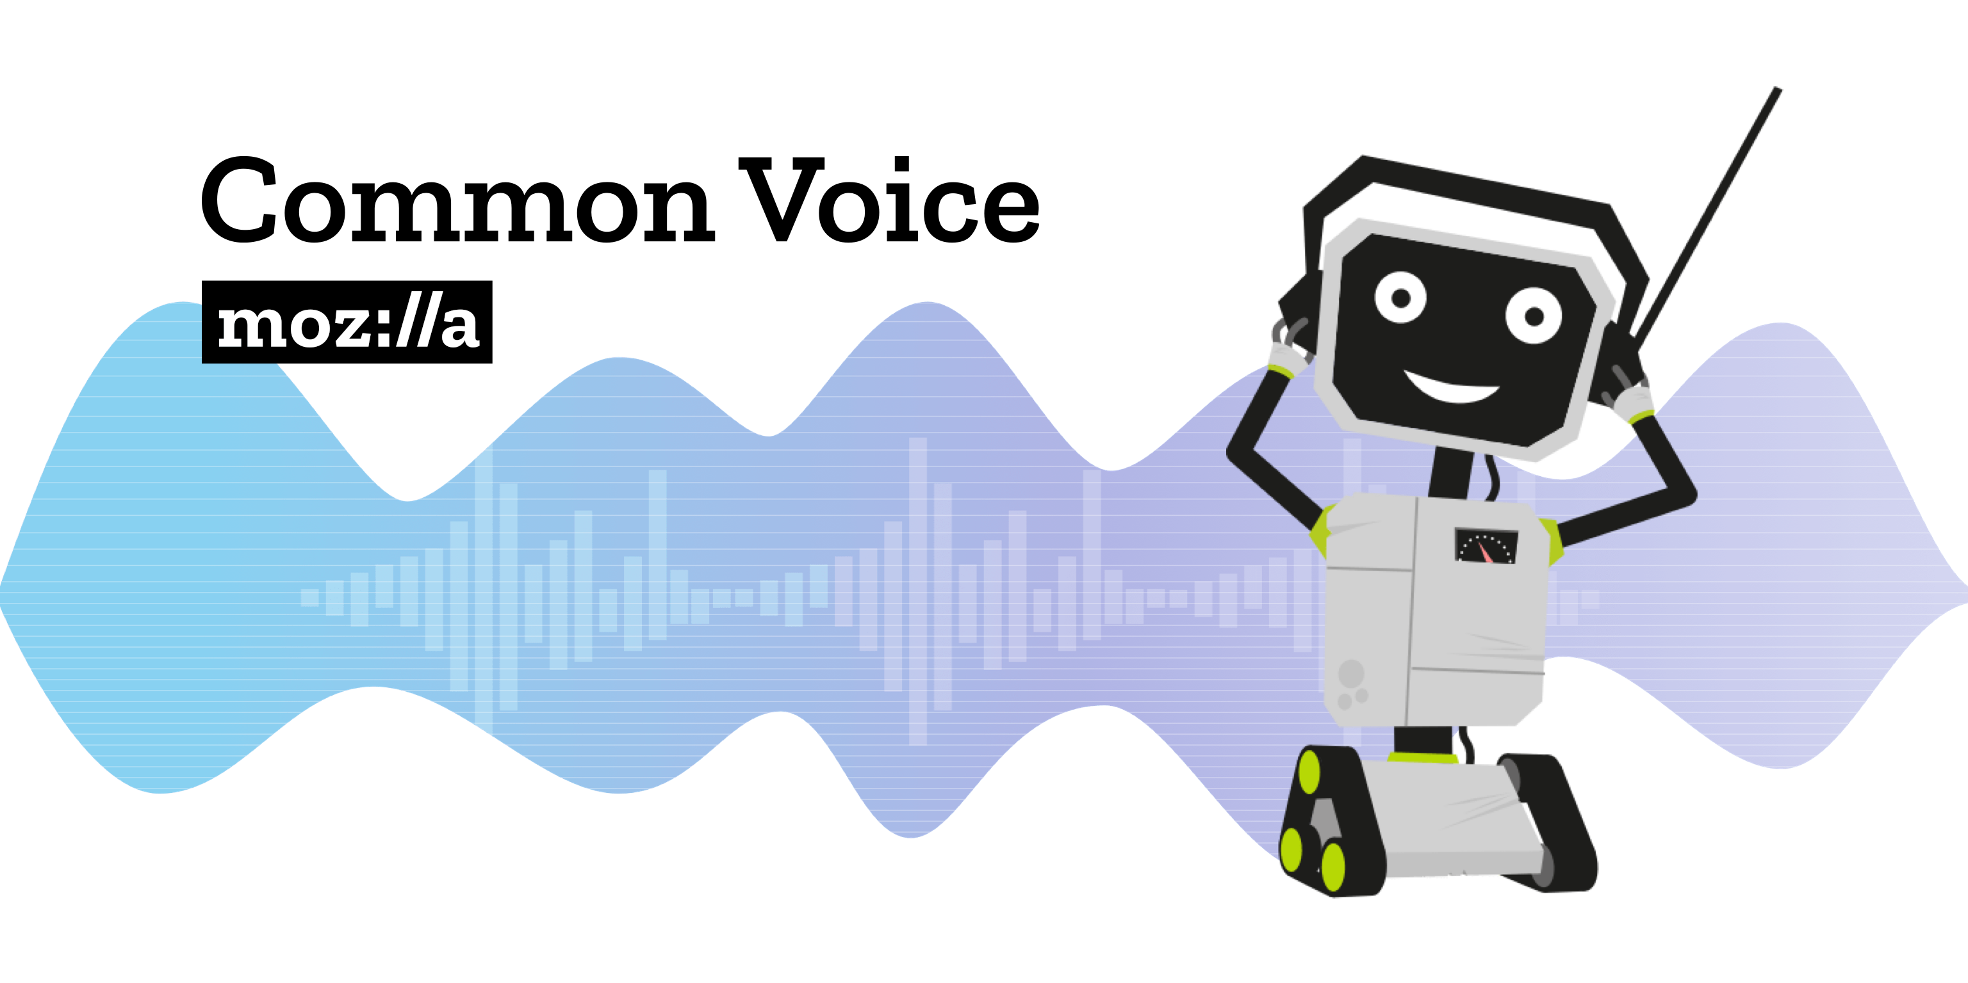
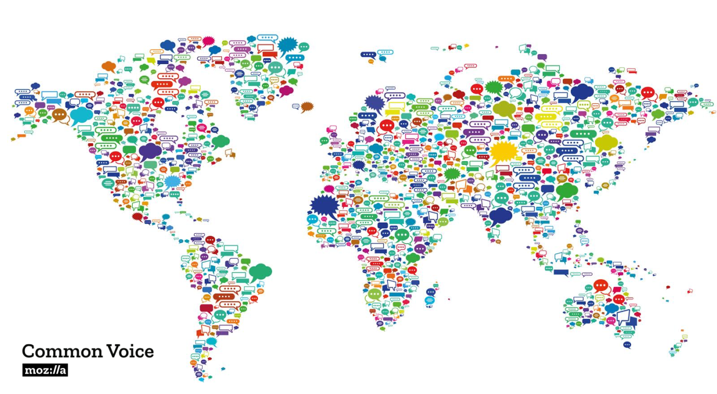
Data Source: Common Voice Mozilla
Crowd-sourced database for speech - recognition
Users can submit their own records
and/or review other records for
accuracy and manual translation
More than a dozen of accents
Includes transcript of the phrase, as
well as age and gender of the
speaker
Overview
Business use case
Data Description
Feature Extraction
Model Summary
Conclusion
Demo

Slide 6
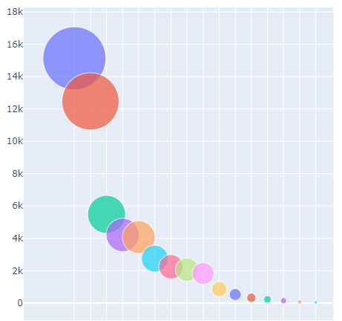
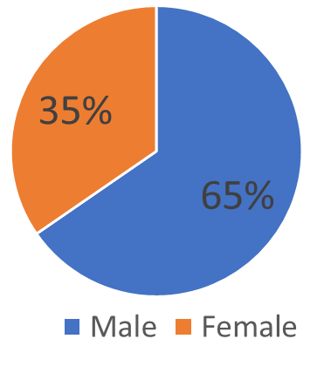
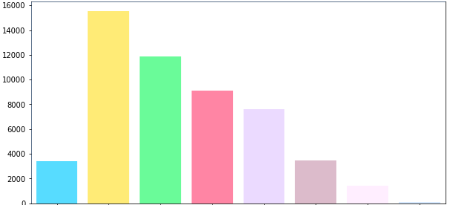
Data Description: Common Voice Mozilla
Select validated voice data files
Filter files for null accent, gender and age
Filter for only positively reviewed
52,000 Audio files
(Audio duration ~ 3-10 seconds)
Types Of Accents (16)
US
England
Distribution Speaker’s Age
Canada
Australia
Indian
Newzealand
Scotland
African
teens | 20s | 30s | 40s | 50s | 60s | 70s | 80s
Ireland
Overview
Business use case
Data Description
Feature Extraction
Model Summary
Conclusion
Demo

Slide 7
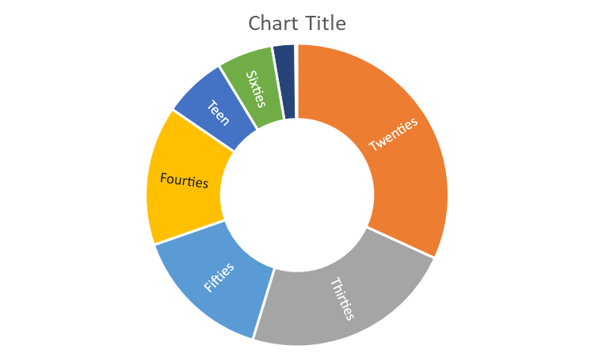
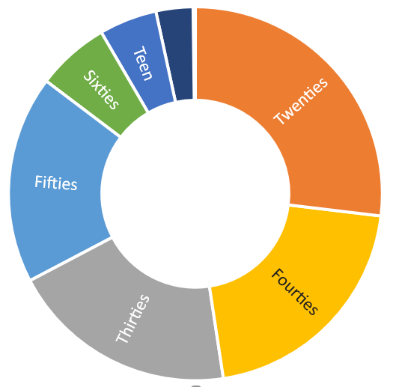
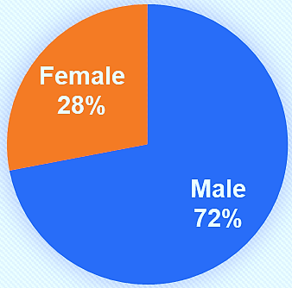
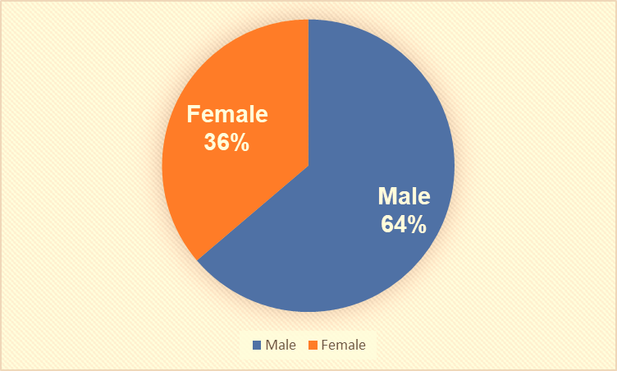
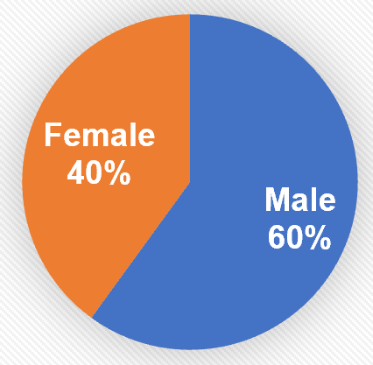
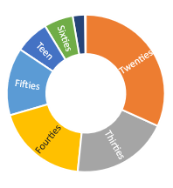
Data Preparation: Three Different Accent Studies
US vs Non-US
Top 5 Accents
Continent-wide
10K
41K
22K
US | 38%
England | 30%
Canada | 13%
North America | 27%
Europe | 35%
India | 13%
Oceania | 25%
US | 50%
Non-US | 50%
India | 10%
Australia | 9%
Female
40%
Age
Age
Age
Age
Male 60%
Overview
Business use case
Data Description
Feature Extraction
Model Summary
Conclusion
Demo
Notes:
that have led to assistants like Alexa and Siri,

Slide 8



Voiced and Voiceless Sounds: Sound Waves
Speech
Voiced Sounds
VoicelessSounds
Opens and closes vocal folds due to constant increasing and decreasing air pressure
When vocal folds are relaxed, it does not produce any vibrations
+
210 Hz
125 Hz
Produce Sound Waves Frequencies
Modulated by articulation and create different resonances by vocal tract
Overview
Business use case
Data Description
Feature Extraction
Model Summary
Conclusion
Demo
Notes:
https://medium.com/@jonathan_hui/speech-recognition-phonetics-d761ea1710c0
Exhale air > opens up vocal folds >> air speeds >> drops the pressure >> closes vocal folds
The same letter in words can pronounce differently.
When producing “th” in “thin”, we will not feel the vibration in our throat.
peech can be classified as voiced and voiceless sounds. as shown in this 2-minute video. For voiced sound, we tense up our vocal folds. When we exhale air from the lungs, it pushes the vocal folds open. The airflow speeds up and the pressure at the vocal fold drops. This closes them again. Once the airflow drops, pressure increases and reopens them. These open and close cycles continue and produce a series of sound wave frequencies with a fundamental frequency average at 125 Hz for men and 210 Hz for women.
Don’t be mistaken by the terms, both produce sounds

Slide 9
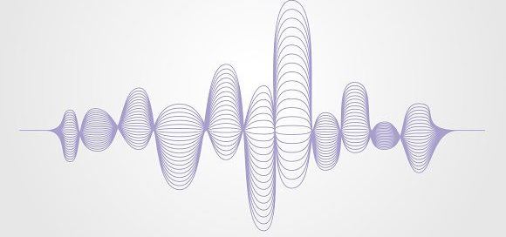
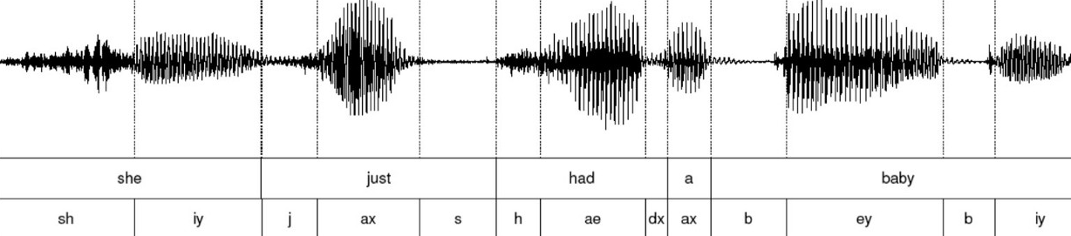
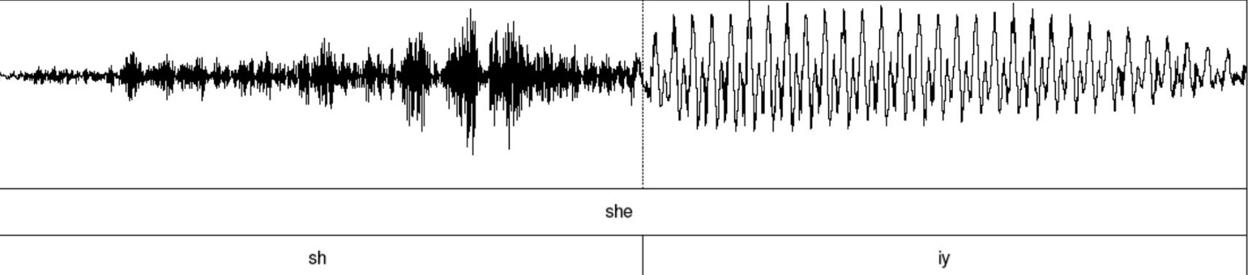
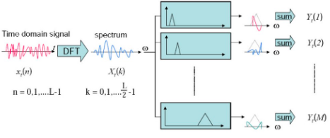
Voiced and Voiceless Sounds: Phonemes
Phoneme representation
Though I coughed roughly and hiccoughed throughout the lecture, I still thought I could plough through the rest of it.
The diagram below transcripts “she just had a baby” with phonemes.
time (t)
time (t)
Denser representation
identifies word easier
Apply the Fourier transform (FFT) to convert time domain information to the frequency domain.
DFT
Discrete Time Frame Window
FFT
STFT
Overlapping Time Frame Window
Overview
Business use case
Data Description
Feature Extraction
Model Summary
Conclusion
Demo
Notes:
https://medium.com/@jonathan_hui/speech-recognition-phonetics-d761ea1710c0
phonemes are an abstract concept in linguistic to distinguish words and phones are how we pronounce them.
When producing “th” in “thin”, we will not feel the vibration in our throat.
phonemes are an abstract concept in linguistic to distinguish words and phones are how we pronounce them.
Don’t be mistaken by the terms, both produce sounds

Slide 10
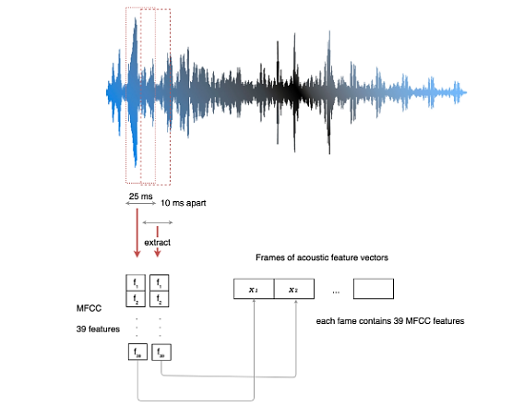
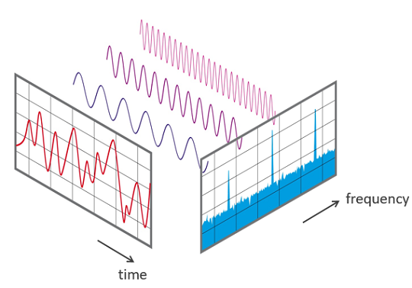
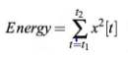
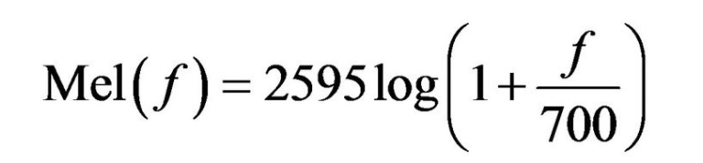
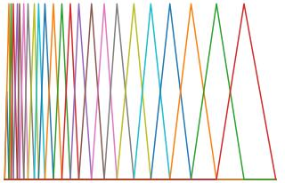
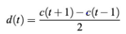
Mel Frequency Cepstral Coefficient (MFCC)
Input speech sample
MFCC
12
Obtain Power Spectrum
Cepstral Coefficients
39
Framing and Windowing
Apply Filterbanks
1
Discrete Fast Fourier Transform
Spectrum
Filterbank
Delta 1
Delta 2
Mel Frequency Transform
64/32
64/32
64/32
Mel Spectrum
Cepstrum
Extract differential and accelerate coefficients
MFCC
Overview
Business use case
Data Description
Feature Extraction
Model Summary
Conclusion
Demo
Notes:
https://medium.com/@jonathan_hui/speech-recognition-phonetics-d761ea1710c0
https://haythamfayek.com/2016/04/21/speech-processing-for-machine-learning.html
These features help us to understand phones. MFCC has 39 features.
We finalize 12 and what are the rest. The 13th parameter is the energy in each frame.
In pronunciation, context and dynamic information are important. Articulations, like stop closures and releases, can be recognized by the formant transitions. Characterizing feature changes over time provides the context information for a phone.
It measures the changes in features from the previous frame to the next frame. This is the first-order derivative of the features.
Another 13 values compute the delta values d(t) below.
The last 13 parameters are the dynamic changes of d(t) from the last frame to the next frame. It acts as the second-order derivative of c(t
Frame the signal into short frames.
For each frame calculate the periodogram estimate of the power spectrum.
Apply the mel filterbank to the power spectra, sum the energy in each filter.
Take the logarithm of all filterbank energies.
Take the DCT of the log filterbank energies.
Keep DCT coefficients 2-13, discard the rest.
phonemes are an abstract concept in linguistic to distinguish words and phones are how we pronounce them.
When producing “th” in “thin”, we will not feel the vibration in our throat.
phonemes are an abstract concept in linguistic to distinguish words and phones are how we pronounce them.
Don’t be mistaken by the terms, both produce sounds

Slide 11



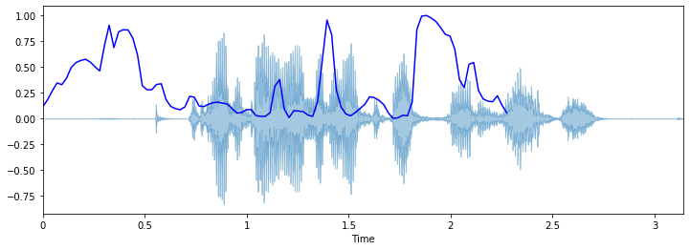
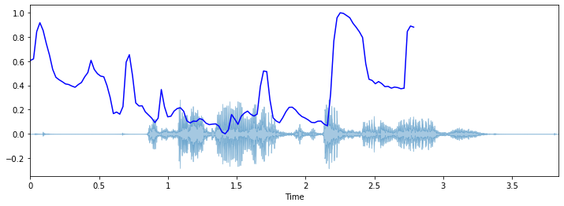


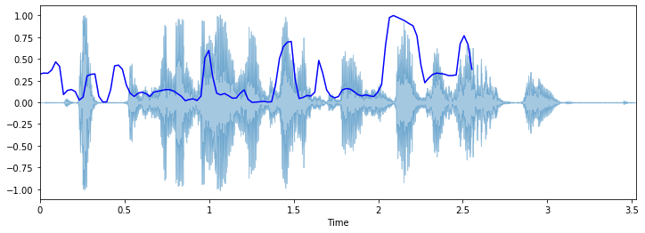
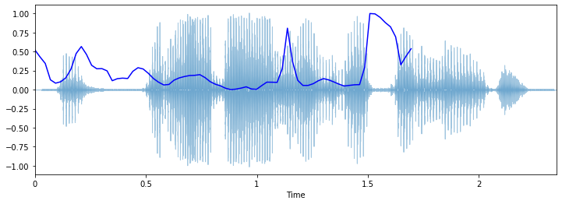
Wave Spectrogram Visualization
it had a diameter of about thirty yards
20Yr
20Yr
60Yr
40Yr
Overview
Business use case
Data Description
Feature Extraction
Model Summary
Conclusion
Demo
Notes:
https://medium.com/@jonathan_hui/speech-recognition-phonetics-d761ea1710c0
phonemes are an abstract concept in linguistic to distinguish words and phones are how we pronounce them.
When producing “th” in “thin”, we will not feel the vibration in our throat.
phonemes are an abstract concept in linguistic to distinguish words and phones are how we pronounce them.
Don’t be mistaken by the terms, both produce sounds

Slide 12
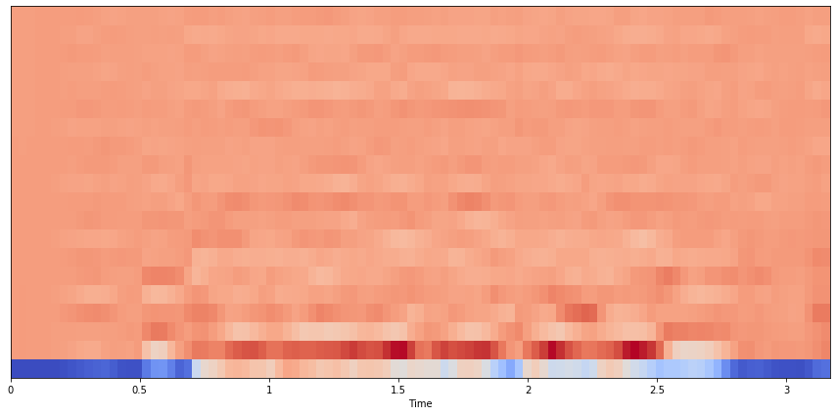
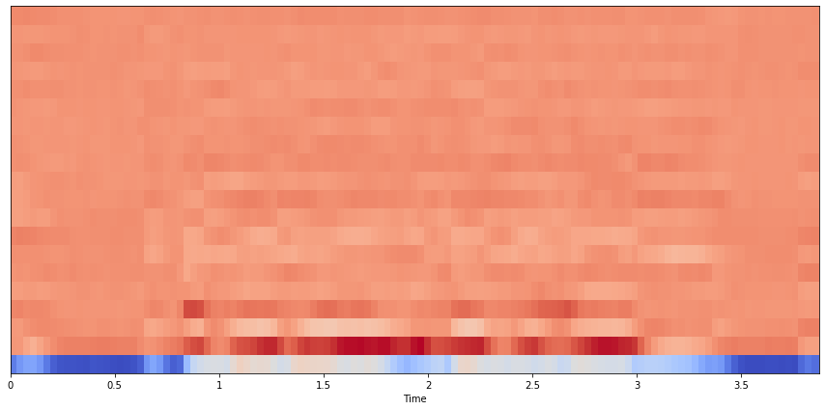
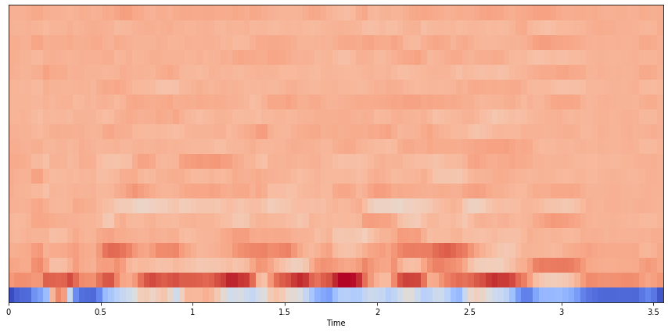
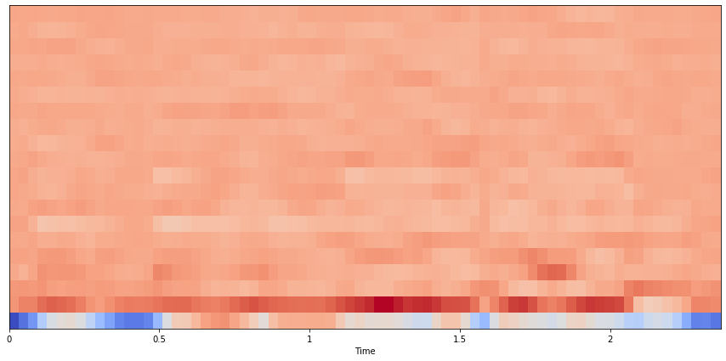
Mel Spectrogram Visualization
it had a diameter of about thirty yards
20Yr
20Yr
60Yr
40Yr
Overview
Business use case
Data Description
Feature Extraction
Model Summary
Conclusion
Demo
Notes:
https://medium.com/@jonathan_hui/speech-recognition-phonetics-d761ea1710c0
phonemes are an abstract concept in linguistic to distinguish words and phones are how we pronounce them.
When producing “th” in “thin”, we will not feel the vibration in our throat.
phonemes are an abstract concept in linguistic to distinguish words and phones are how we pronounce them.
Don’t be mistaken by the terms, both produce sounds

Slide 13
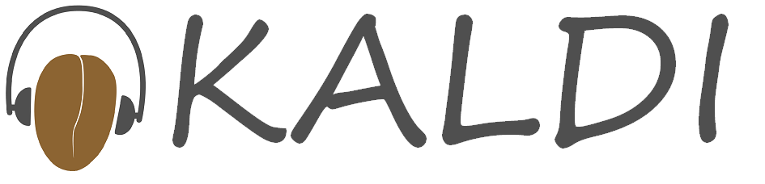


Project Workflow
Loading Trimming
Step 1: Loading wav files through librosa
Extraction
Step 3: Extracting features using Kaldi-toolkit
Fitting Prediction
Step 5: Fitting train data Convolutional/Bidirectional LSTM
Step 2: Trimming long silences in the wav file
Step 6: Predicting accents by frames
Features: MFCC + Filterbank + delta_1 + delta_2
Step 7: Label majority vote of accent from frames to speaker
Step 4: Appending Gender and Age along with voice features
Target Variable: Frame level accent vector
Overview
Business use case
Data Description
Feature Extraction
Model Summary
Conclusion
Demo
Notes:
https://medium.com/@jonathan_hui/speech-recognition-phonetics-d761ea1710c0
phonemes are an abstract concept in linguistic to distinguish words and phones are how we pronounce them.
When producing “th” in “thin”, we will not feel the vibration in our throat.
phonemes are an abstract concept in linguistic to distinguish words and phones are how we pronounce them.
Don’t be mistaken by the terms, both produce sounds

Slide 14
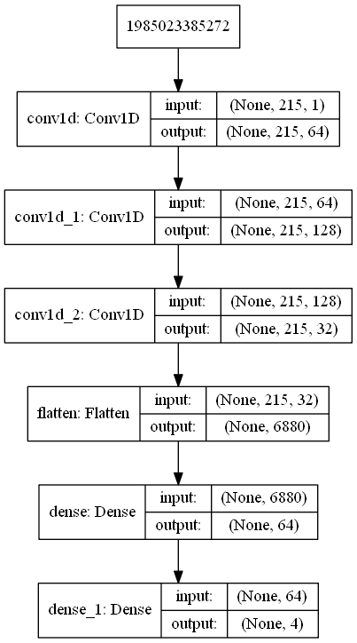
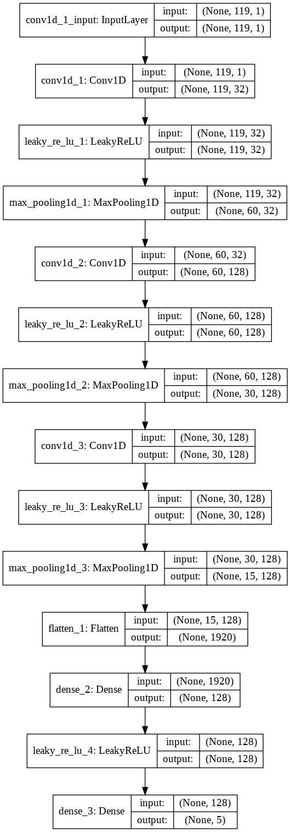
Model Network Structure
Convolutional NN
Bidirectional LSTM
Continent
Top 5 & US/Non US
Top 5
Compact version
BatchNormalization
Dropout
LeakyRelu
Maxpooling
Compact
Version
Compact
Version
Overview
Business use case
Data Description
Feature Extraction
Model Summary
Conclusion
Demo
Notes:
https://medium.com/@jonathan_hui/speech-recognition-phonetics-d761ea1710c0
phonemes are an abstract concept in linguistic to distinguish words and phones are how we pronounce them.
When producing “th” in “thin”, we will not feel the vibration in our throat.
phonemes are an abstract concept in linguistic to distinguish words and phones are how we pronounce them.
Don’t be mistaken by the terms, both produce sounds

Slide 15
Model Framework
119
Speech Feature Extraction
Continent (Under-sampled)
Top 5 accents
US/Non-US
Feature Vector
215
119
Train: 50%
Validation: 20%
Test: 30%
CNN
Bi-LSTM, CNN
CNN
Overview
Business use case
Data Description
Feature Extraction
Model Summary
Conclusion
Demo
Notes:
https://medium.com/@jonathan_hui/speech-recognition-phonetics-d761ea1710c0
phonemes are an abstract concept in linguistic to distinguish words and phones are how we pronounce them.
When producing “th” in “thin”, we will not feel the vibration in our throat.
phonemes are an abstract concept in linguistic to distinguish words and phones are how we pronounce them.
Don’t be mistaken by the terms, both produce sounds

Slide 16
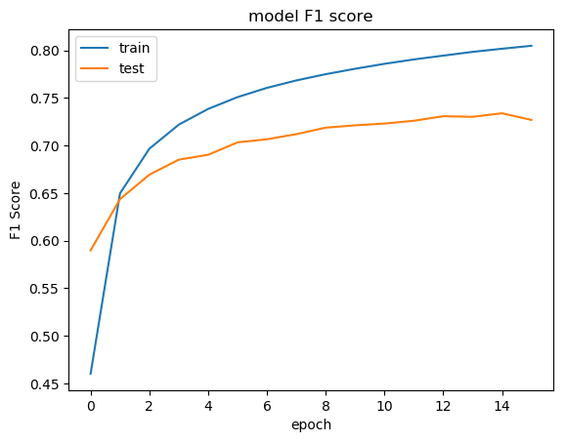
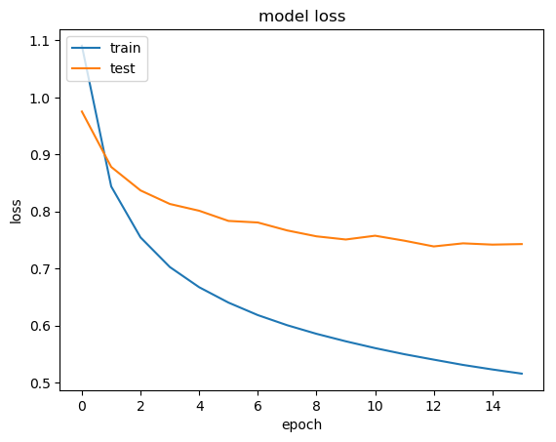
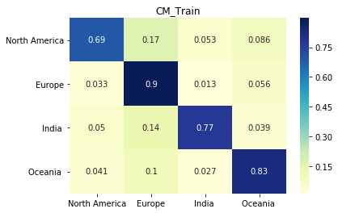
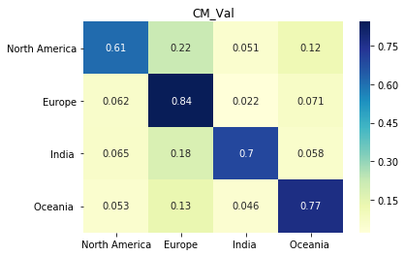
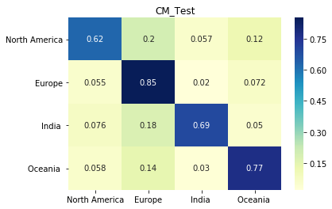
Model Continent: Convolutional NN
F1 Score
Model Loss
Overall
Dataset | Frame F1 Score | Speaker F1- Score
Train | 0.832 | 0.883
Validation | 0.758 | 0.796
Test | 0.760 | 0.798
Test
Speaker Level
Accent Label | Precision | Recall | F1 score | Support
North America | 0.79 | 0.71 | 0.75 | 1800
Europe | 0.82 | 0.85 | 0.83 | 2342
India | 0.73 | 0.81 | 0.77 | 900
Oceania | 0.81 | 0.82 | 0.82 | 1573
F1 Score
Loss
Epochs
Train
Val
Test
Overview
Business use case
Data Description
Feature Extraction
Model Summary
Conclusion
Demo
Notes:
https://medium.com/@jonathan_hui/speech-recognition-phonetics-d761ea1710c0
phonemes are an abstract concept in linguistic to distinguish words and phones are how we pronounce them.
When producing “th” in “thin”, we will not feel the vibration in our throat.
phonemes are an abstract concept in linguistic to distinguish words and phones are how we pronounce them.
Don’t be mistaken by the terms, both produce sounds

Slide 17
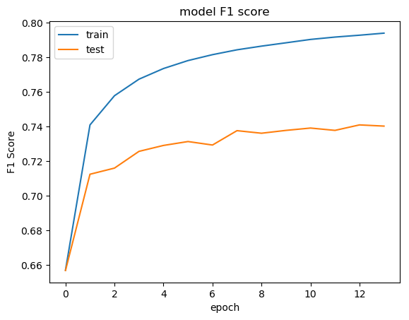
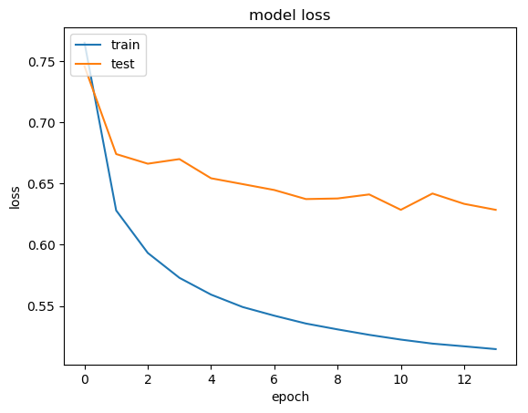
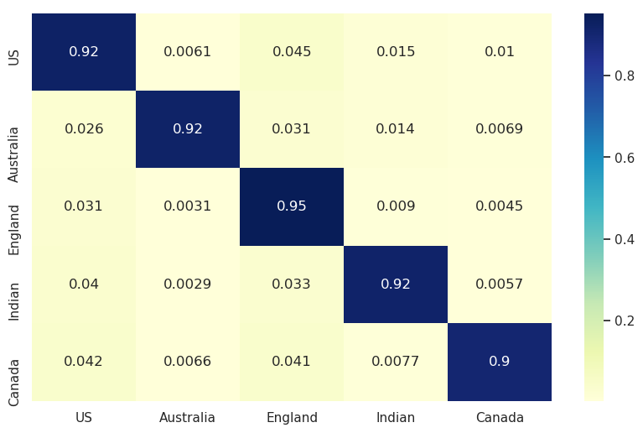
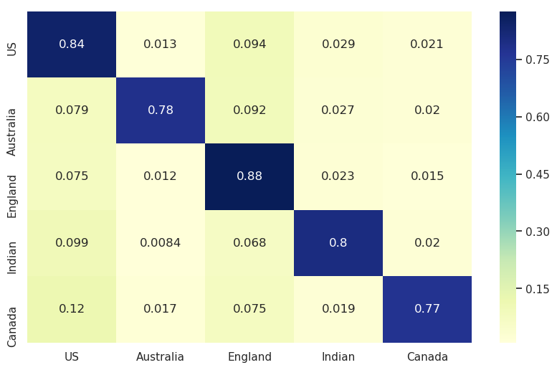
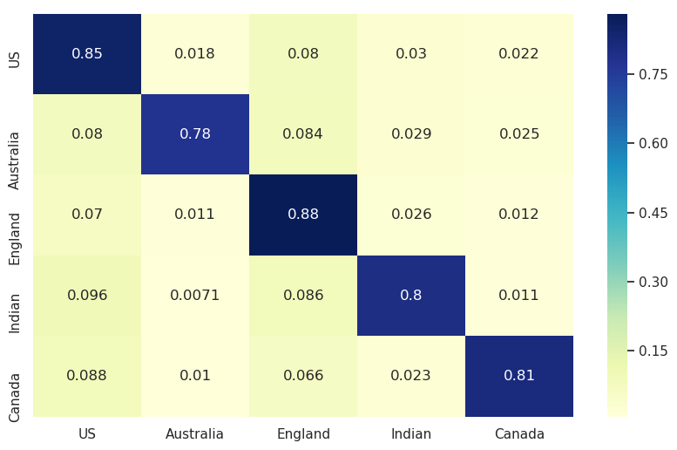
Model Top 5 Accents: Convolutional NN
F1 Score
Model Loss
Overall
Dataset | Frame F1 Score | Speaker F1- Score
Train | 0.808 | 0.929
Validation | 0.733 | 0.833
Test | 0.733 | 0.8426
F1 Score
Test
Speaker Level
Accent Label | Precision | Recall | F1 score | Support
US | 0.86 | 0.85 | 0.86 | 4536
Australia | 0.87 | 0.78 | 0.82 | 1222
England | 0.83 | 0.88 | 0.85 | 3736
Indian | 0.77 | 0.80 | 0.78 | 1260
Canada | 0.88 | 0.81 | 0.84 | 1644
Loss
Epochs
Train
Val
Test
Overview
Business use case
Data Description
Feature Extraction
Model Summary
Conclusion
Demo
Notes:
https://medium.com/@jonathan_hui/speech-recognition-phonetics-d761ea1710c0
phonemes are an abstract concept in linguistic to distinguish words and phones are how we pronounce them.
When producing “th” in “thin”, we will not feel the vibration in our throat.
phonemes are an abstract concept in linguistic to distinguish words and phones are how we pronounce them.
Don’t be mistaken by the terms, both produce sounds

Slide 18
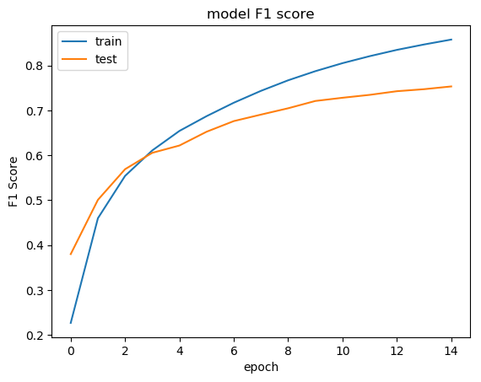
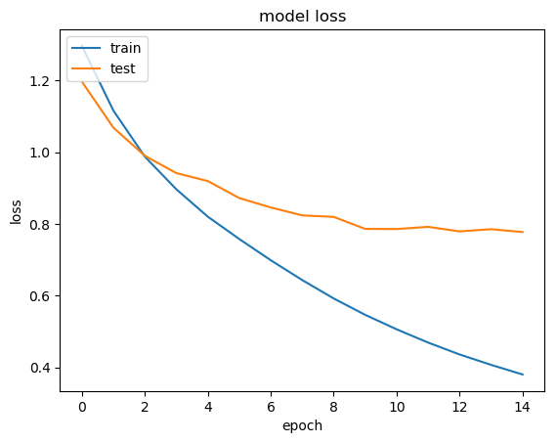
Model Top 5 Accents: Bidirectional LSTM
F1 Score
Model Loss
Overall
Dataset | Frame F1 Score | Speaker F1- Score
Train | 0.832 | 0.883
Validation | 0.758 | 0.796
Test | 0.760 | 0.798
F1 Score
Test
Speaker Level
Accent Label | Precision | Recall | F1 score | Support
US | 0.89 | 0.86 | 0.87 | 4600
Australia | 0.85 | 0.80 | 0.83 | 1200
England | 0.88 | 0.83 | 0.85 | 3729
Indian | 0.79 | 0.82 | 0.80 | 1240
Canada | 0.90 | 0.84 | 0.88 | 1650
Loss
Epochs
Train
Val
Test
Overview
Business use case
Data Description
Feature Extraction
Model Summary
Conclusion
Demo
Notes:
https://medium.com/@jonathan_hui/speech-recognition-phonetics-d761ea1710c0
phonemes are an abstract concept in linguistic to distinguish words and phones are how we pronounce them.
When producing “th” in “thin”, we will not feel the vibration in our throat.
phonemes are an abstract concept in linguistic to distinguish words and phones are how we pronounce them.
Don’t be mistaken by the terms, both produce sounds

Slide 19
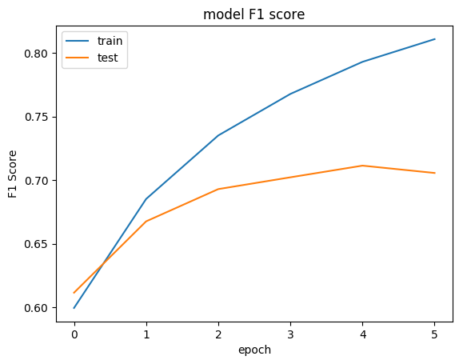
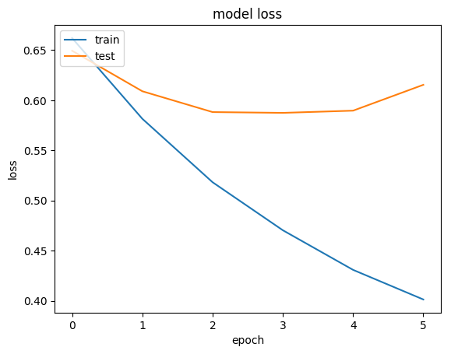
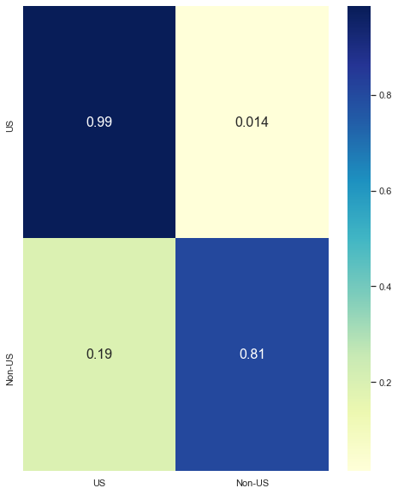
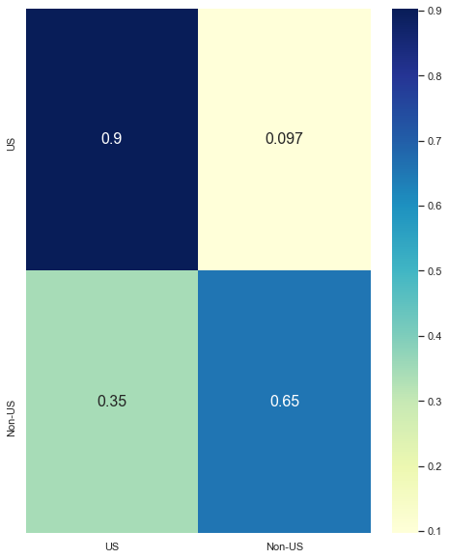

Model US/Non US: Convolutional NN
F1 Score
Model Loss
Overall
Dataset | Frame F1 Score | Speaker F1- Score
Train | 0.796 | 0.886
Validation | 0.684 | 0.750
Test | 0.690 | 0.765
F1 Score
Loss
Test
Speaker Level
Accent Label | Precision | Recall | F1 score | Support
US | 0.71 | 0.92 | 0.81 | 1459
Non-US | 0.90 | 0.67 | 0.77 | 1535
Epochs
Train
Val
Test
Overview
Business use case
Data Description
Feature Extraction
Model Summary
Conclusion
Demo
Notes:
https://medium.com/@jonathan_hui/speech-recognition-phonetics-d761ea1710c0
phonemes are an abstract concept in linguistic to distinguish words and phones are how we pronounce them.
When producing “th” in “thin”, we will not feel the vibration in our throat.
phonemes are an abstract concept in linguistic to distinguish words and phones are how we pronounce them.
Don’t be mistaken by the terms, both produce sounds

Slide 20
Models Summary
Dataset | Best-predicted accent (F1 – speaker level)
Continents | Europe
Top 5 | US
US/Non-US | US
Overview
Business use case
Data Description
Feature Extraction
Model Summary
Conclusion
Demo
Notes:
https://medium.com/@jonathan_hui/speech-recognition-phonetics-d761ea1710c0
phonemes are an abstract concept in linguistic to distinguish words and phones are how we pronounce them.
When producing “th” in “thin”, we will not feel the vibration in our throat.
phonemes are an abstract concept in linguistic to distinguish words and phones are how we pronounce them.
Don’t be mistaken by the terms, both produce sounds

Slide 21

What we have achieved?
Achievements
Utilization of three different DL models
Voice feature extraction at frame level
Consistent prediction at speaker level by all 3 models
Improvements
BLSTM/LSTM can apply to continent-wide and US/Non-US datasets
Use of more complex DL models and architectures
Ensemble results
Discover additional voice features
Dependency on Gender and Age: Will model be same after removal of gender/age attributes ??
Challenges
Computational Run-time
Understanding and handling of voice data
Overview
Business use case
Data Description
Feature Extraction
Model Summary
Conclusion
Demo
Notes:
https://medium.com/@jonathan_hui/speech-recognition-phonetics-d761ea1710c0
phonemes are an abstract concept in linguistic to distinguish words and phones are how we pronounce them.
When producing “th” in “thin”, we will not feel the vibration in our throat.
phonemes are an abstract concept in linguistic to distinguish words and phones are how we pronounce them.
Don’t be mistaken by the terms, both produce sounds

Slide 22

Demo

Slide 23
Extra slides onwards

Slide 24

Continent
CNN1D
Top 5 & US/Non US
CNN1D

Slide 25




Feature – Wave Spectrogram
it had a diameter of about thirty yards
Overview
Business use case
Data Description
Feature Extraction
Model Summary
Conclusion
Demo
Notes:
https://medium.com/@jonathan_hui/speech-recognition-phonetics-d761ea1710c0
phonemes are an abstract concept in linguistic to distinguish words and phones are how we pronounce them.
When producing “th” in “thin”, we will not feel the vibration in our throat.
phonemes are an abstract concept in linguistic to distinguish words and phones are how we pronounce them.
Don’t be mistaken by the terms, both produce sounds

